Slide 1


Marina Housing Element Update
Workshop #1: November 9, 2022

Slide 2
Introduction

Slide 3
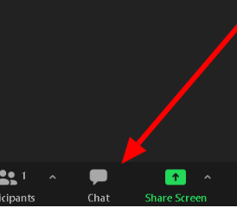
Housekeeping Items
Technology happens – please be flexible and patient!
Discussion/Q&A at the end of the workshop.
Please mute yourself when you are not speaking.
Use the chat feature if you have any questions or comments during the presentation.
One person speaks at a time. Keep comments brief. You may turn on or keep your camera off when speaking.

Slide 4
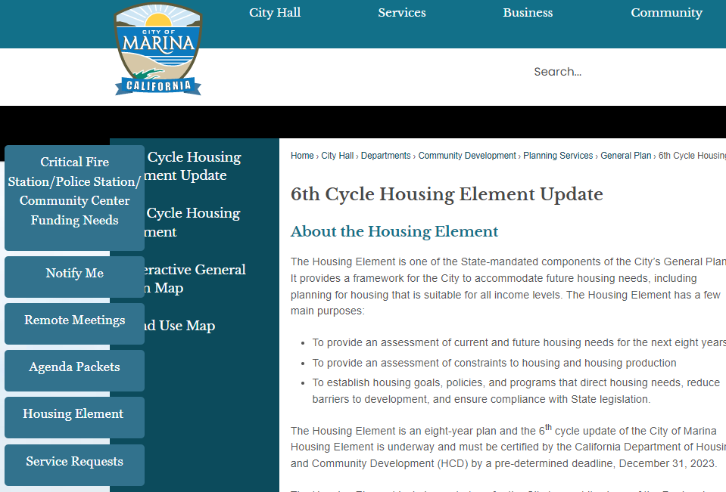

Housing Element Update Materials
Project website will include all information on the project, upcoming events, and ways to stay involved
https://cityofmarina.org/1186/6th-Cycle-Housing-Element-Update

Slide 5
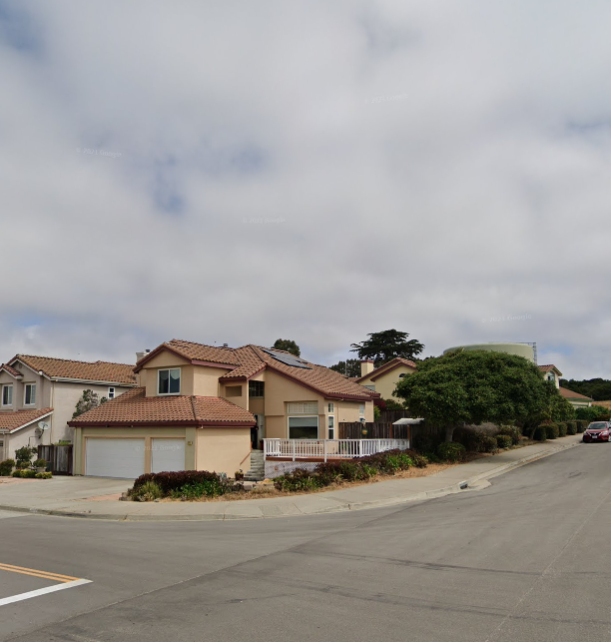
Agenda
Welcome and Introductions (6:30-6:40)
Icebreaker/Poll Questions (6:40– 6:50)
Housing Element Presentation (6:50-7:20)
Discussion and Q&A (7:20–7:50)
Get Involved and Next Steps (7:50-8:00)

Slide 6
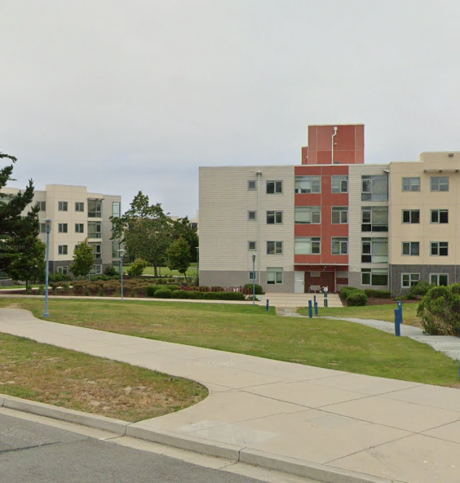
Project Team
City of Marina
Guido Persicone, Community Development Director
Consultant Team
Rincon Consultants, Inc
Veronica Tam and Associates, Inc.

Slide 7
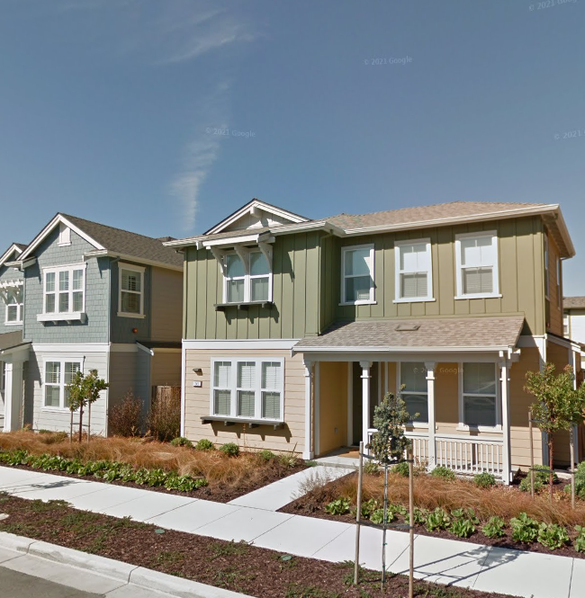
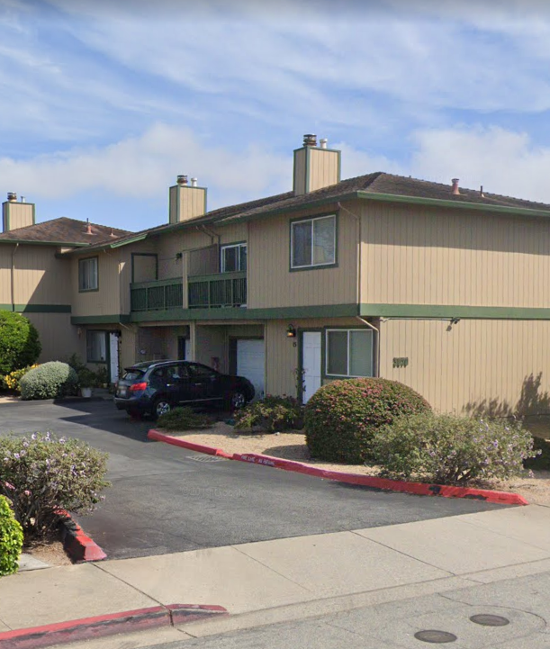
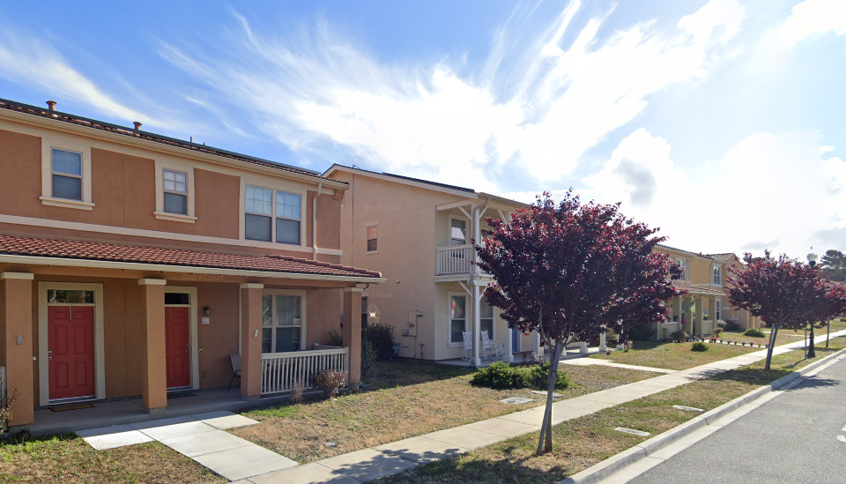
Poll Questions
Answer the following questions within the chat feature.
State whether you live and/or work in Marina, or if you don’t live but are interested in housing.
On a scale of 1 – 5 how familiar are you with Housing Elements?

Slide 8

Housing Element Basics

Slide 9
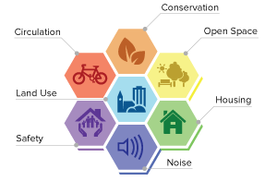
What is a Housing Element?
One of eight mandatory elements of the General Plan
Governed by California Government Code Article 10.6 (Sections 65580-65589.11)
Updated every 8 years
Only element that MUST be approved and certified by State

Slide 10
Housing Element Components
Housing Needs Assessment
Evaluation of Past Performance
Housing Sites Inventory
Constraints Analysis
Policies and Actions
Review prior Housing Element policies and programs
Available sites for all income levels based on the Regional Housing Needs Allocation (RHNA)
Analysis of barriers to housing development
Policies and actions to fulfill identified housing needs
Housing trends, conditions, and needs

Slide 11

New State Legislation
SB35: Streamlined review (2017)
SB 166: No Net Loss Zoning (2017)
AB 686: Affirmatively Furthering Fair Housing (2018)
SB 330: Housing Crisis Act (2019)
California Comeback Plan: 31 new bills (2021)
SB 9: Single-Family Lot Splits (2021)
AB 2011 and SB 6: Residential Development in Commercial Zones (2022)

Slide 12
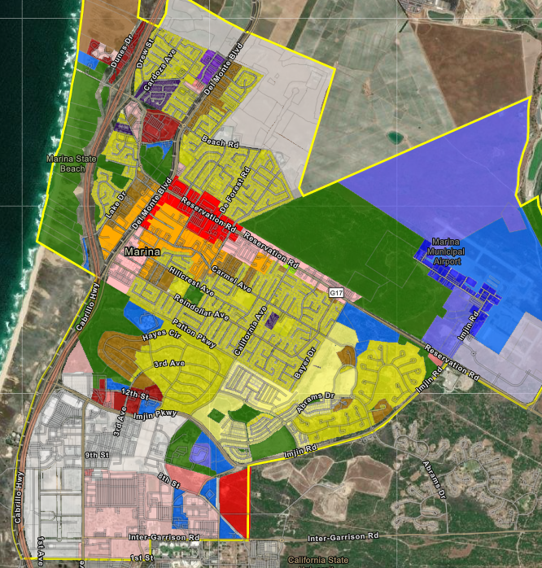
Housing Element Site Inventory
Used to identify sites to meet the City’s Regional Housing Needs Allocation (RHNA)
RHNA is the minimum number of housing units each community is required to provide “adequate sites” through zoning and aim to construct
One of the primary criteria necessary to achieve HCD certification

Slide 13
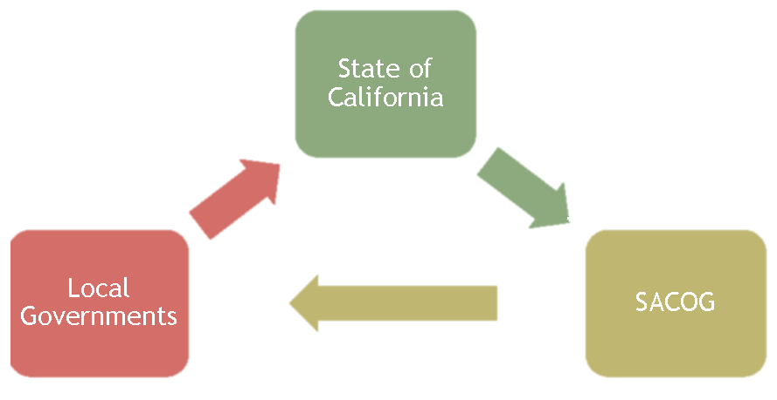
How is RHNA distributed?
Housing
Element
Updates
RHNA
Determination
AMBAG
RHNA Methodology

Slide 14
Household Income and Housing Affordability
Very Low Income
Low Income
Moderate Income
31% to 50% AMI ($24,480 to $40,800 per year)
51% to 80% AMI ($40,800to $65,280 per year)
80% to 120% AMI ($65,280 to $97,920 per year)
Above Moderate
Over 120% AMI (Over $97,920 per year)
Income categories defined by the State based on percentages of the Area Median Income (AMI) in Monterey County for a household of four: $81,600

Slide 15
RHNA allocations for the City of Marina
6th Cycle RHNA Allocation
Very Low | 94
Low | 62
Moderate | 173
Above Moderate | 356

Slide 16
How can Marina satisfy its RHNA in the Site Inventory?
1. Existing housing projects under review
2. Accessory Dwelling Unit trends
3. Identify vacant and underutilized land that allows housing
4. If needed, rezone areas for housing
5. Implement policies/programs to overcome constraints to housing development and implement new State laws

Slide 17
Housing Needs

Slide 18
Population and Housing Unit Growth
Marina’s population grew by about 9% over the last decade compared to 4.5% in the overall County
Housing production exceeded population growth in Marina
Median home prices, however, have doubled since 2015
Source: CA Dept. of Finance Population and Housing Estimates for Cities, Counties and the State, (2010-2021)

Slide 19
Housing Cost Burden by Income in Marina
About 17% of all households spend more than 50% of their income on housing
Lower income households are more cost burdened
Renters are more cost burdened than homeowners
Source: HUD Comprehensive Housing Affordability Strategy (CHAS) Data, 2015-2019.

Slide 20
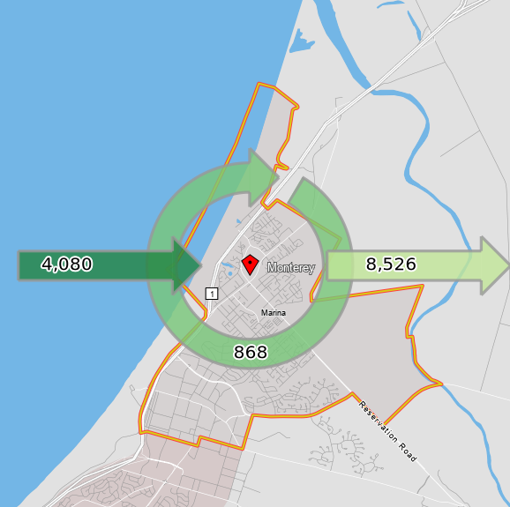
Employment and Housing
Most of the workforce in Marina live in the city but work elsewhere
Marina is a net exporter of workers
About 20% of the people who work in Marina live in the city

Slide 21

Discussion

Slide 22
Discussion Questions
What are the top housing challenges in Marina?
What groups are most impacted by housing challenges and what types of housing would be most appropriate to serve them?
What kinds of tools and strategies would you like for Marina to consider and use to improve housing in the city?

Slide 23
Next Steps

Slide 24
Tentative Schedule
Planning Commission Study Session
November 10, 2022
Community Workshop 2
Site Inventory and Fair Housing
February/March 2023
Draft Housing Element for Public Review
March/April 2023
Public Hearings on Draft Housing Element
April/May 2023
Submit Housing Element to State HCD for review
June 2023

Slide 25





Stay Involved
Upcoming
Workshops
Survey
Written Comments
Formal Hearings

Slide 26
Thank you! Contact us with any questions or additional comments: Guido Persicone: gpersicone@cityofmarina.org Ryan Russell: rrussell@rinconconsultants.com

